Slide 1
Publishing options:
Hungarian institute associated authors

Slide 2
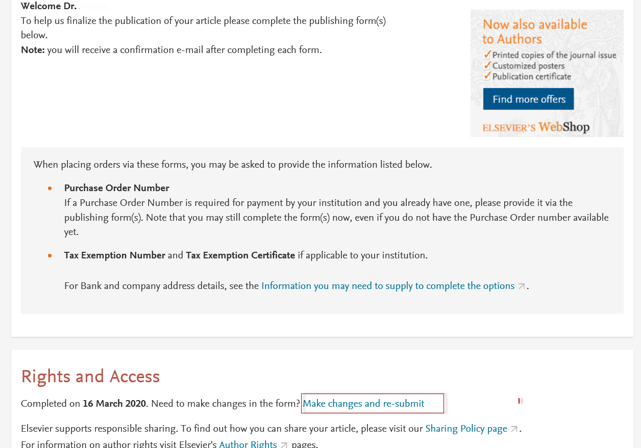
Corresponding author receives an email post acceptance with an unique link to complete the author journey and choose publishing options
Author clicks on ‘make changes and re-submit link’

Slide 3
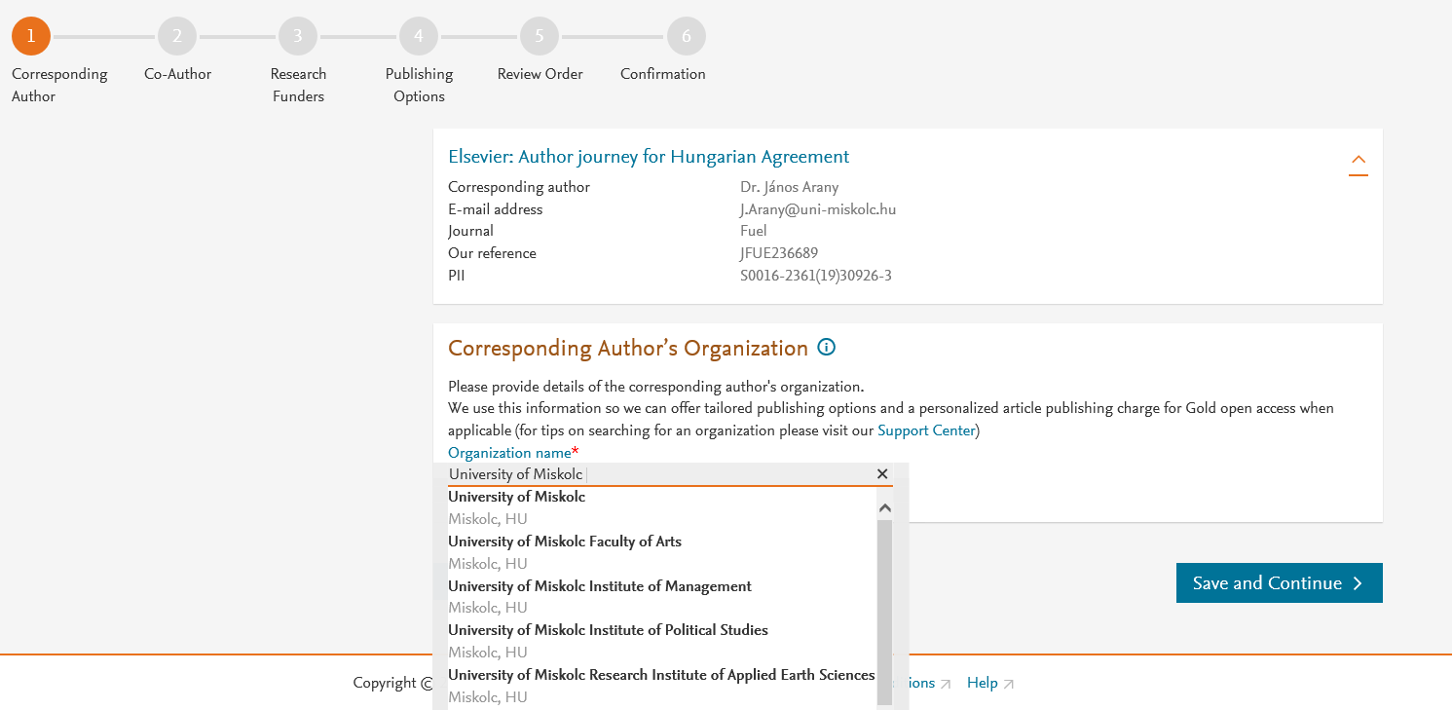
Corresponding author selects his/her affiliation details which we use to identify the authors and match them to the Hungarian agreement

Slide 4
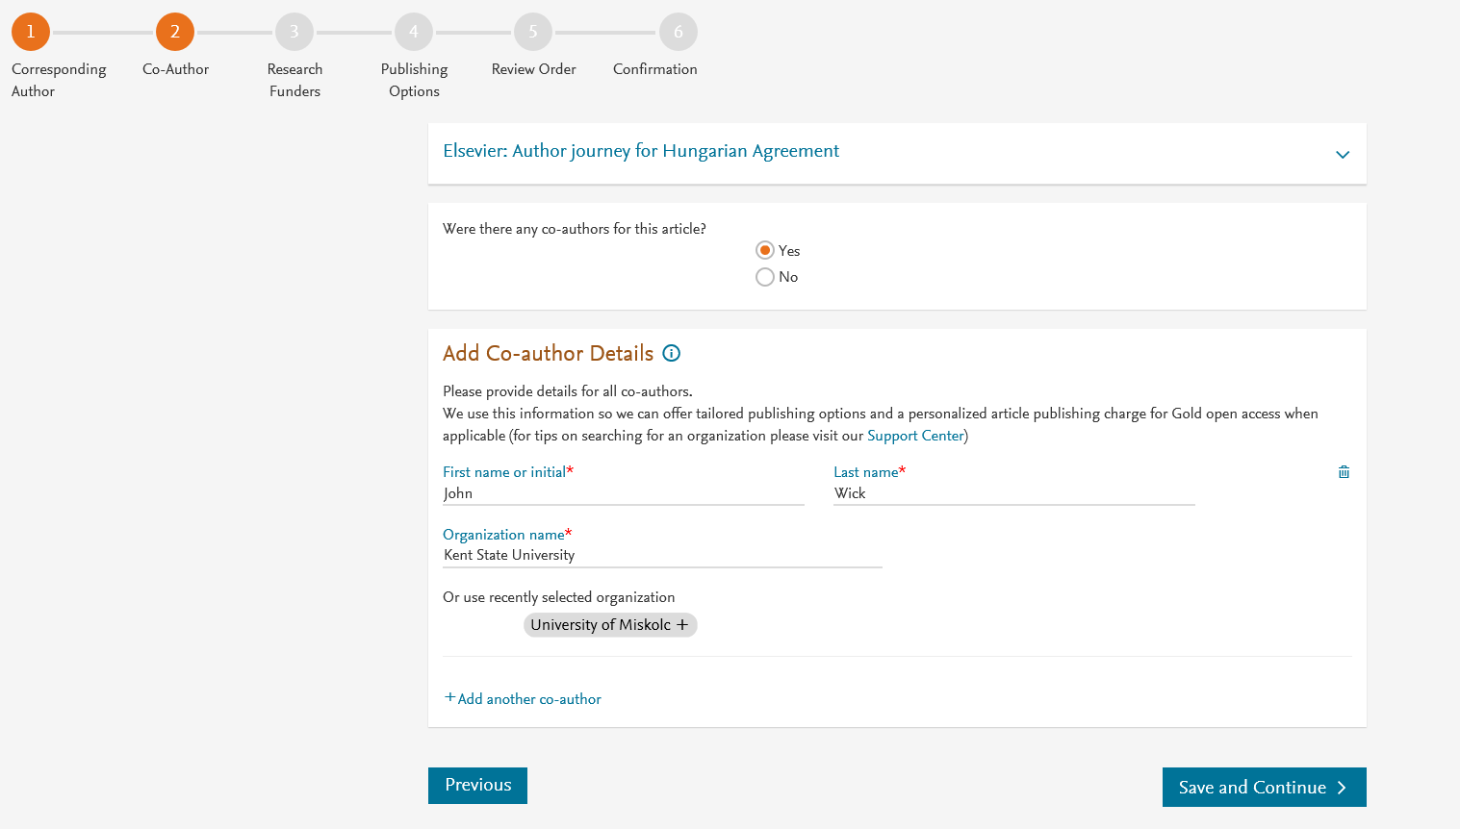
Corresponding author also adds the co-author affiliation details

Slide 5
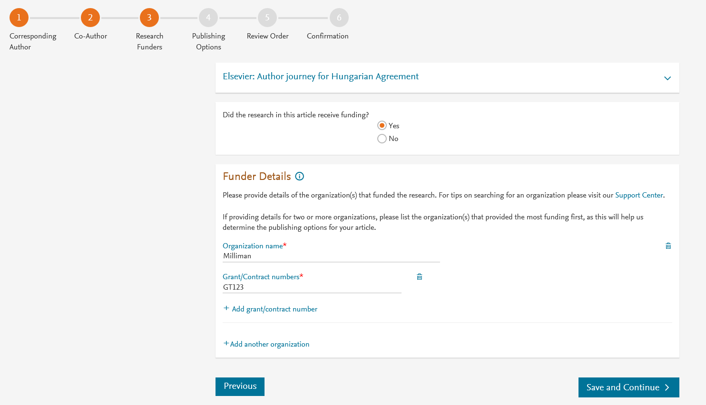
Author can add the Funder details. Funder can be the affiliated institute or a different one. In this case Milliman, United States is the Funder

Slide 6
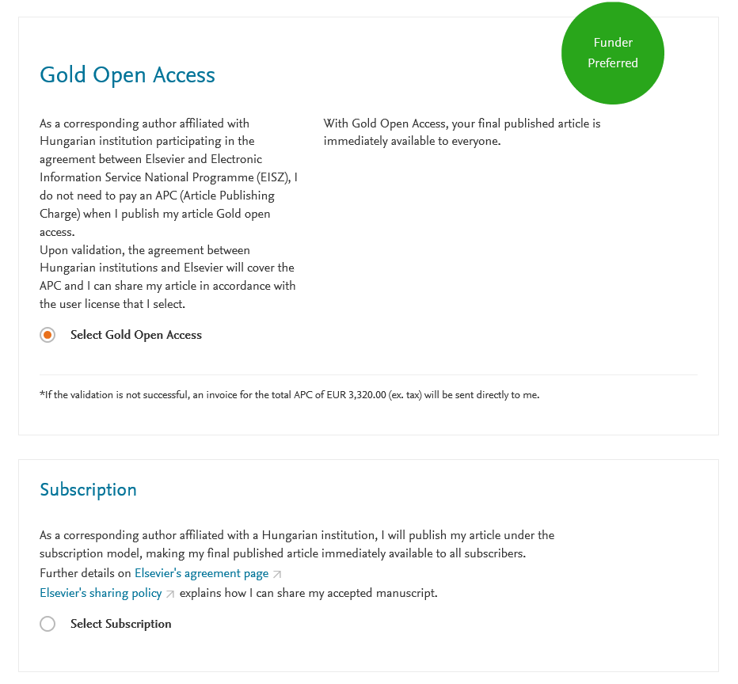
Based on the affiliation details, the author sees the Publishing Options. Gold OA option is followed by Subscription option and we make it clear that agreement covers full APC
If the librarian at the institution rejects the author request in the Elsevier Portal, we also make it clear that the authors will receive a full price invoice
In hybrid journals, in case of no funding, the authors can contact support@elsevier.com within 2 weeks of receiving an invoice and change the publishing model to Subscription

Slide 7
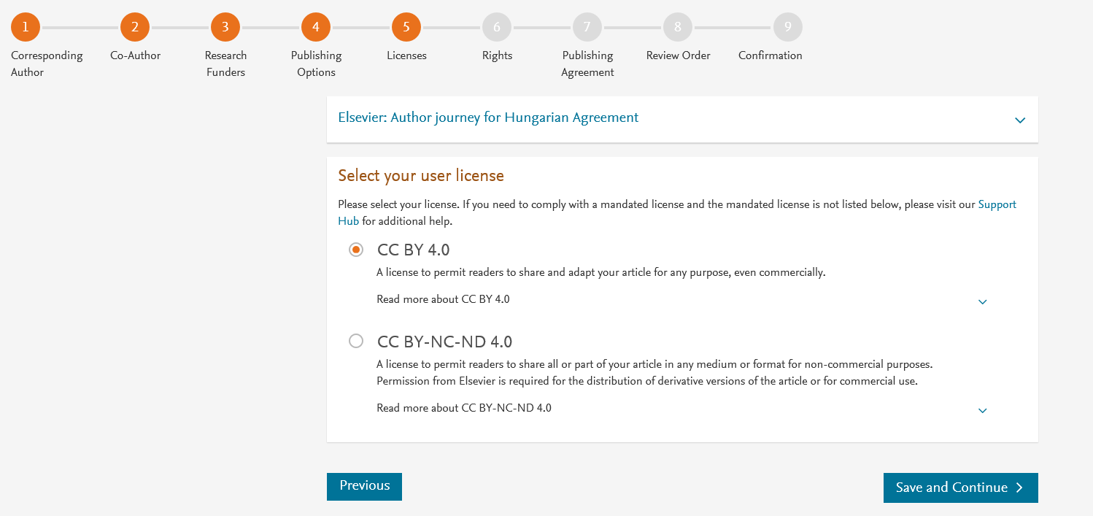
In case of OA, author selects the CC License

Slide 8
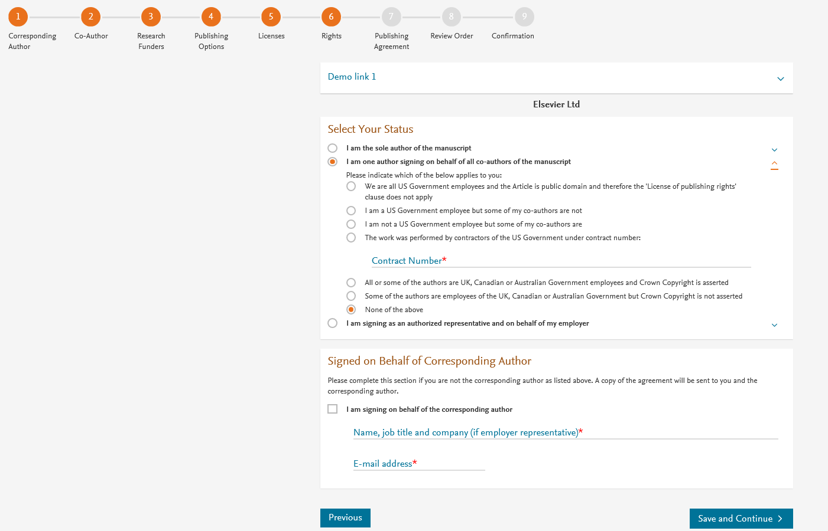
Author selects the rights

Slide 9
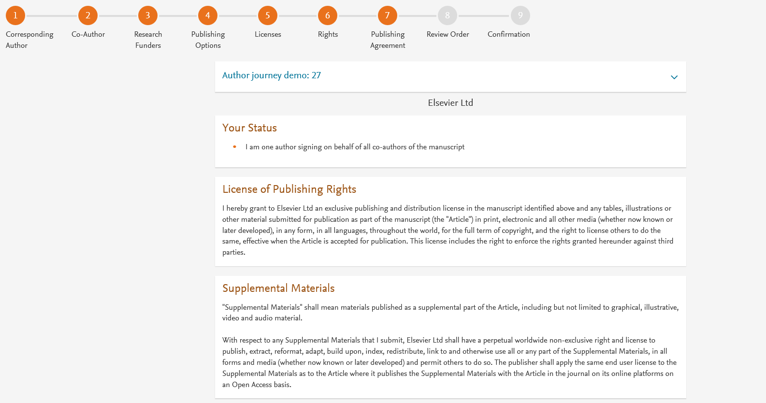
System presents author with the Journal License Publishing Agreement

Slide 10
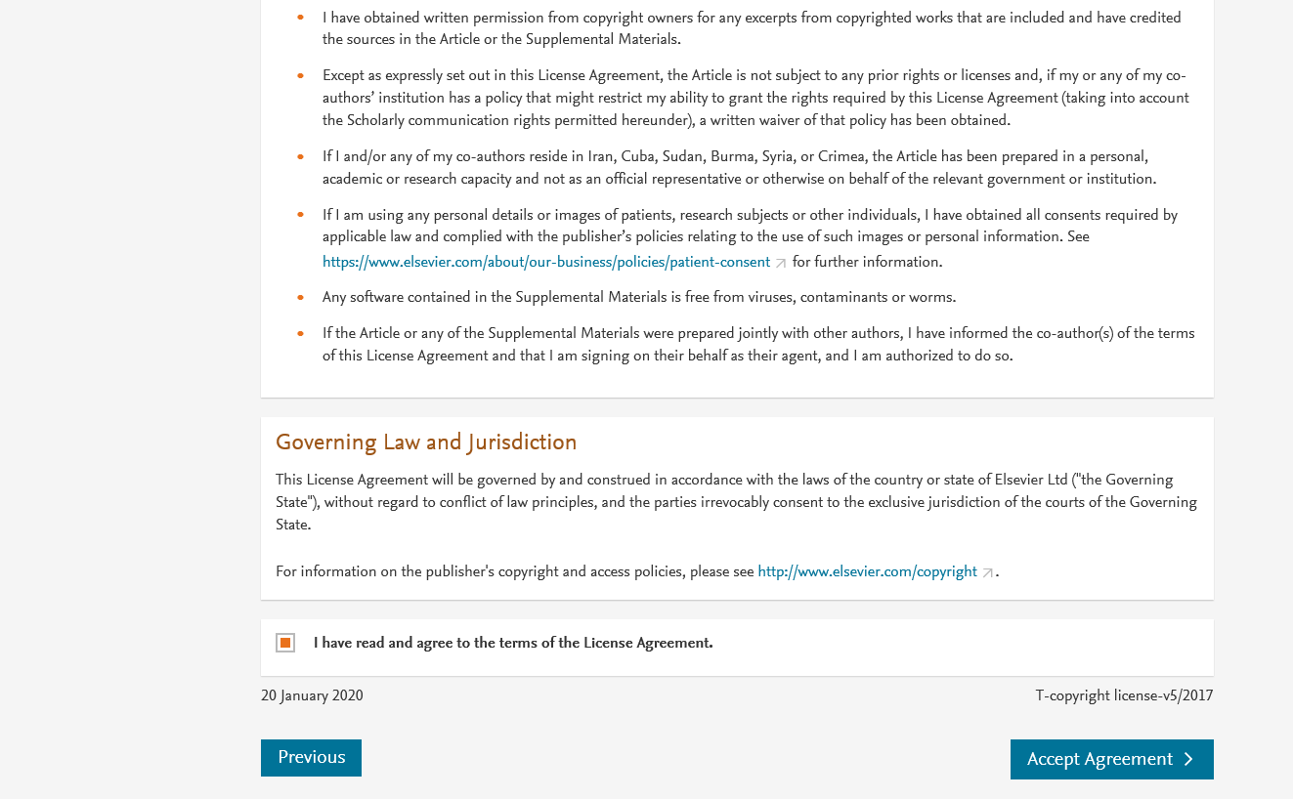
Authors agrees to the Journal License Publishing Agreement

Slide 11
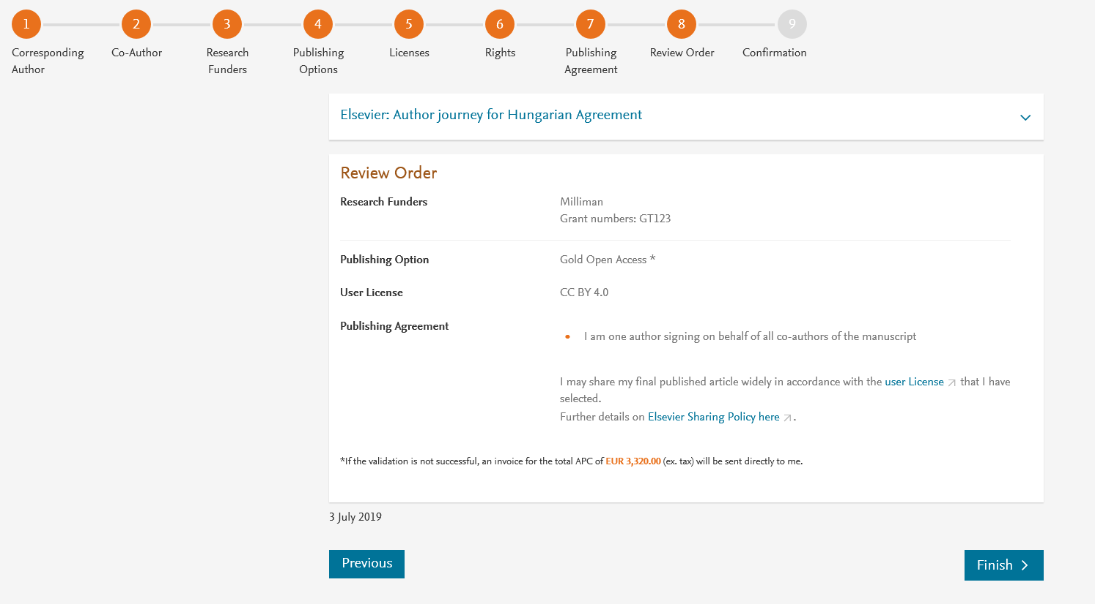
This is the summary page explaining the choices the author made in the publishing journey
Corresponding author receives a copy of summary via email

